Slide 1
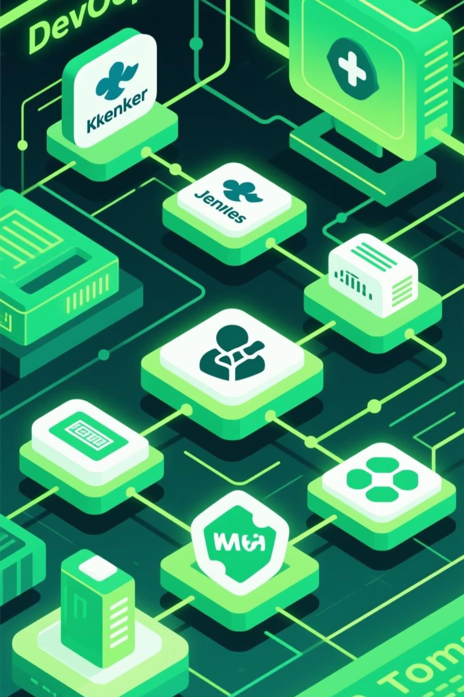
Implementing a DevOps Pipeline on Windows
A Project-Based Learning Approach with Kubernetes, Jenkins, Maven, Tomcat, and Spring Boot
Submitted by:2310030012: Ruthwik PVN2310030111: Aniket OJHA
Under the guidance of Dr. MTrinath BasuDepartment of Computer Science and EngineeringKoneru Lakshmaiah Education Foundation

Slide 2
Project Overview & Objectives
1
Configure a complete DevOps environment on Windows
2
Bridge development and operations
3
Create a practical learning environment
Install and integrate Docker Desktop with Kubernetes, Apache Tomcat, Maven, Jenkins, and Spring Boot to create a functional CI/CD pipeline on a single machine.
Demonstrate how modern DevOps practices eliminate traditional gaps between development teams and operations teams through automation, containerization, and continuous delivery.
Provide hands-on experience with industry-standard tools that simulate real-world DevOps workflows while maintaining a manageable scope for academic exploration.
This project replaces traditional software development cycles with an automated pipeline that enables faster, more reliable application delivery while providing valuable insights into DevOps principles and practices.

Slide 3
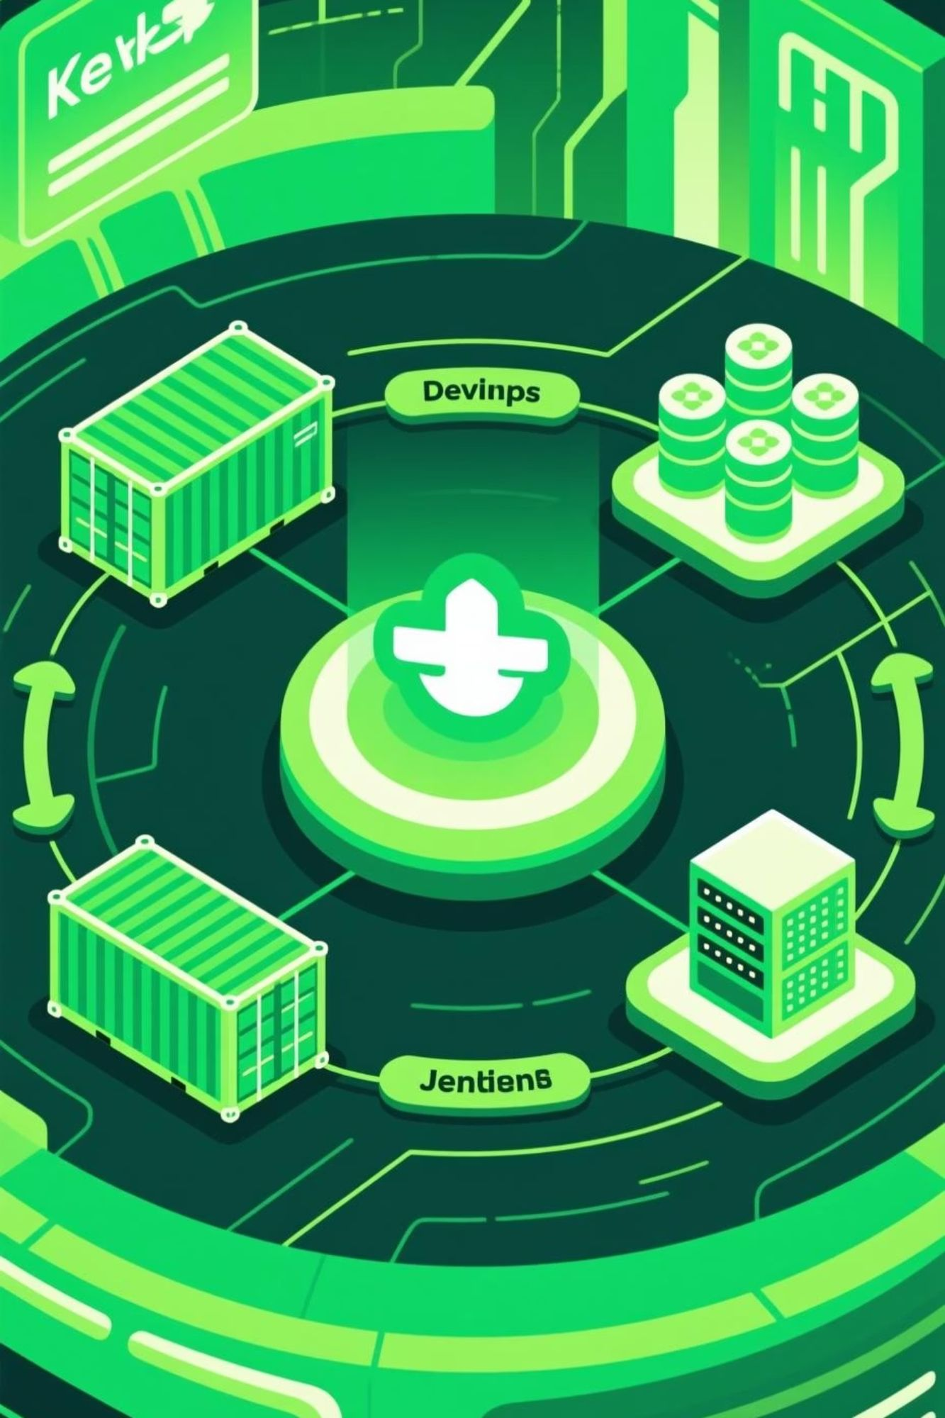






The DevOps Ecosystem
Docker
Provides lightweight, portable containers ensuring applications run consistently across all environments, eliminating the "it works on my machine" problem.
Kubernetes
Orchestrates containers at scale, handling critical operational tasks like scaling, failover, load balancing, and self-healing deployment management.
Jenkins
Functions as the automation engine for CI/CD, integrating with other tools to automate building, testing, and deployment processes through configurable pipelines.
Maven
Automates build processes and dependency management, ensuring reproducible builds and streamlining the software compilation process.
Tomcat
Serves as the application server for Java-based web applications, providing a reliable runtime environment for deployed applications.
Spring Boot
Simplifies Java application development with auto-configuration, making it easier to create production-ready applications and microservices.

Slide 4
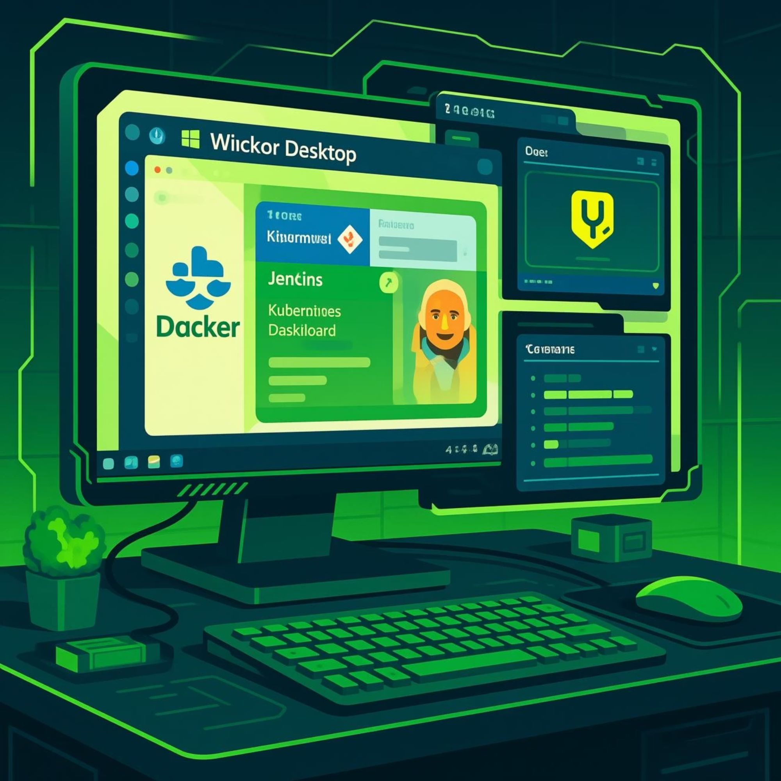
System Requirements & Setup
Hardware & Software Requirements
Operating System: Windows 10/11
Processor: Intel i5 or higher
Memory: Minimum 8GB RAM
Storage: 20GB+ free space
Virtualization: Enabled in BIOS
Prerequisites: Java JDK 8 or higher
Set up Java environment & tools
Install & configure Jenkins
Install Docker Desktop with Kubernetes
Install JDK, Apache Tomcat (set CATALINA_HOME), and Apache Maven (set MAVEN_HOME). Configure system PATH variables to include all binaries.
Download Jenkins WAR file and run with java -jar jenkins.war --httpPort=9090. Complete initial setup and install recommended plugins.
Download and install Docker Desktop from the official website, then enable Kubernetes from settings panel. Verify with docker --version and kubectl version.

Slide 5
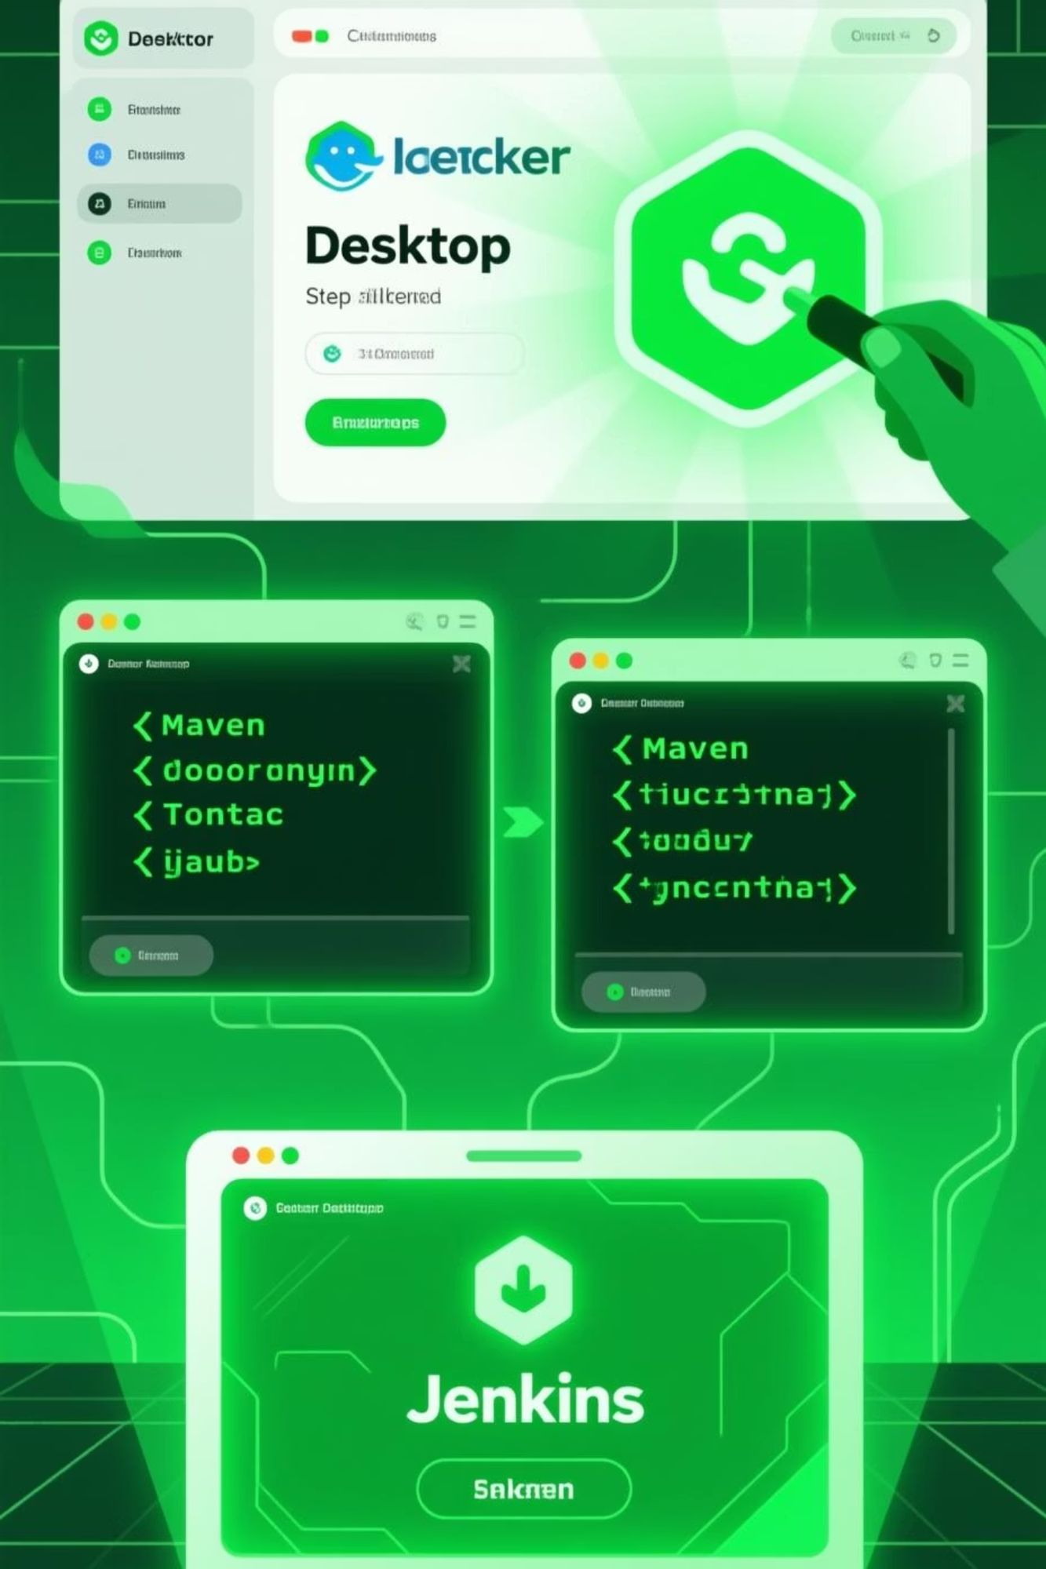



Installation Workflow
Docker Desktop
Download from docker.com
Run installer with defaults
Enable Kubernetes in settings
Verify: kubectl get nodes
Tomcat & Maven
Extract Tomcat to C:\tomcat
Set CATALINA_HOME
Extract Maven to C:\maven
Set MAVEN_HOME
Update PATH variable
Jenkins
Run as WAR file
Access localhost:9090
Unlock with initial password
Install suggested plugins
Create admin user
The installation process establishes all the core components required for our DevOps environment. Each tool is configured to work together, creating an integrated ecosystem on a single Windows machine.

Slide 6
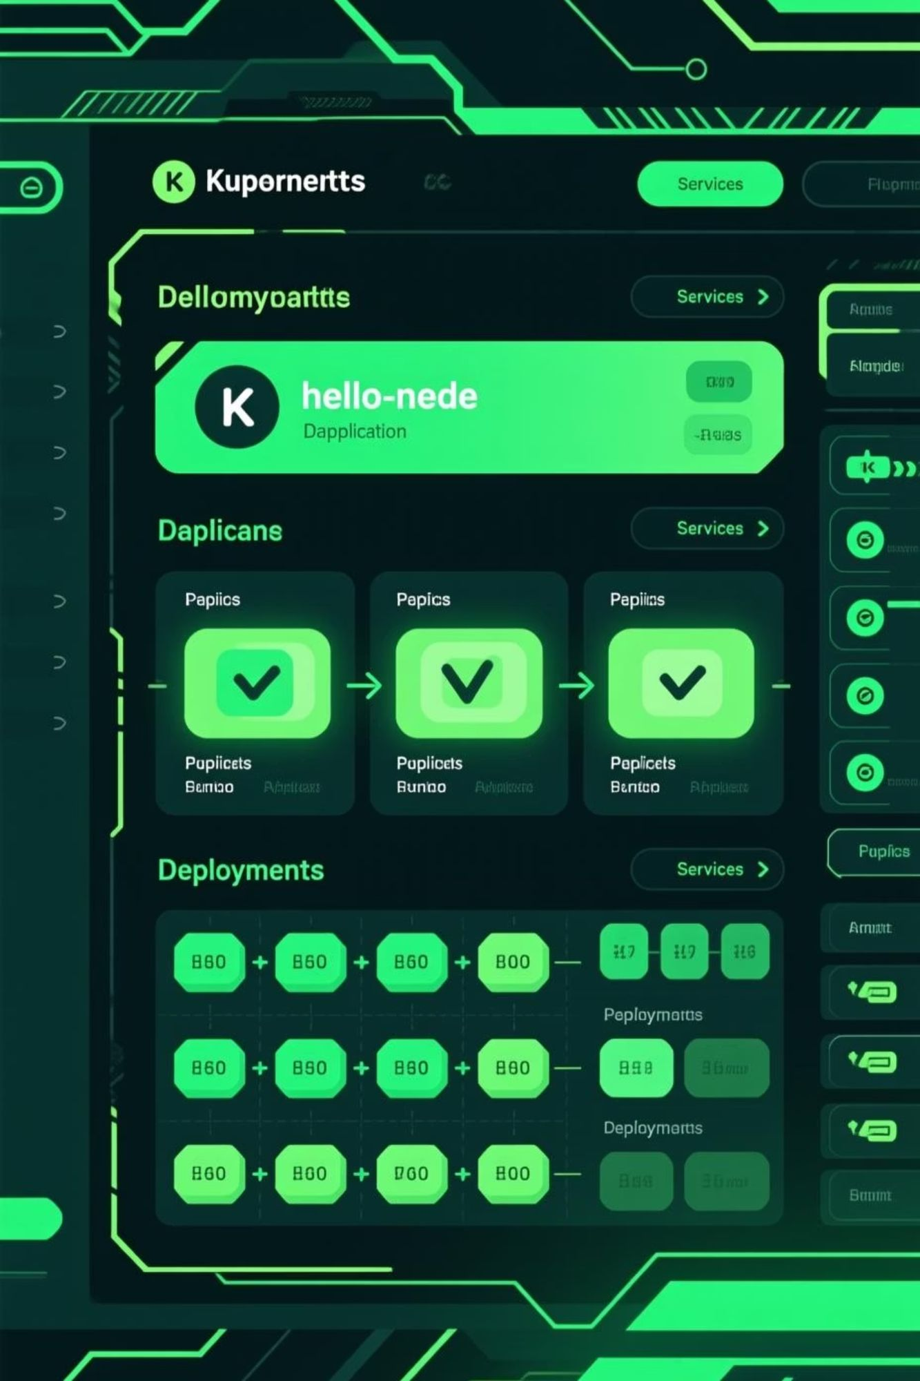
Basic Kubernetes Deployment
Step-by-Step Kubernetes Deployment
Understanding the Deployment
# Create a deploymentkubectl create deployment hello-node \ --image=k8s.gcr.io/echoserver:1.4# Expose the deployment as a servicekubectl expose deployment hello-node \ --type=LoadBalancer --port=8080# Verify running podskubectl get pods# Check service statuskubectl get services hello-node
This basic deployment demonstrates Kubernetes orchestration capabilities:
Creates a containerized application (echoserver)
Exposes it via a load balancer service
Automatically manages pod lifecycle
Provides a stable endpoint for access
Kubernetes abstracts away infrastructure complexity, allowing developers to focus on application logic rather than deployment details.

Slide 7
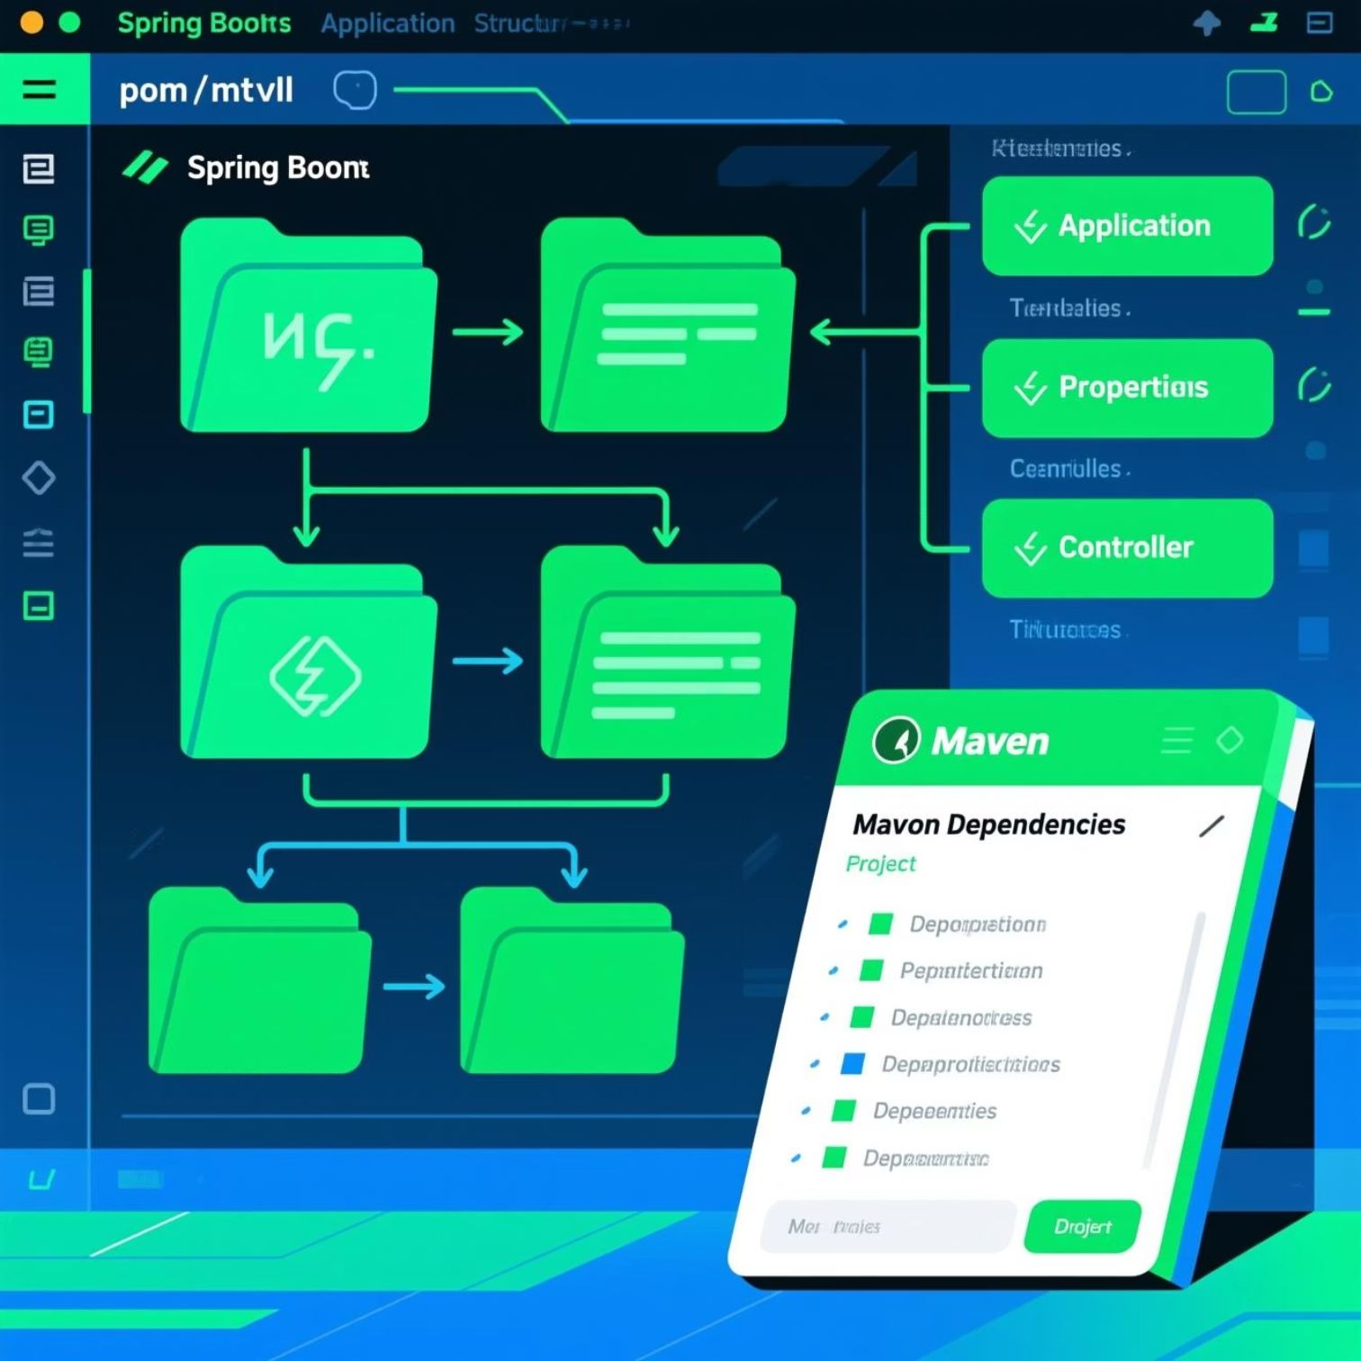
Spring Boot Integration
Creating a Simple Spring Boot Application
Spring Boot significantly simplifies Java application development through:
Auto-configuration: Eliminates boilerplate setup code
Embedded servers: Includes Tomcat by default
Starter dependencies: Pre-configured modules for common use cases
Production-ready features: Metrics, health checks, externalized configuration
# Create and run a Spring Boot applicationmvn spring-boot:run# Build a deployable JAR/WARmvn clean package
Spring Boot's simplified development model integrates perfectly with our DevOps pipeline, enabling rapid creation of microservices that can be containerized and deployed through the same automated workflow. Its embedded Tomcat server also provides an alternative to standalone Tomcat for simpler applications.

Slide 8
Complete CI/CD Workflow
01
02
03
Code Commit & Webhook Trigger
Automated Build with Maven
Docker Image Creation
Developer pushes code to GitHub repository, which triggers a webhook notification to Jenkins.
Jenkins executes Maven build job that compiles the application, runs tests, and packages it as a WAR file.
Jenkins builds a Docker image containing the application and Tomcat, then tags it with a version identifier.
04
05
Container Registry Push
Kubernetes Deployment
The tagged Docker image is pushed to a container registry (Docker Hub or private registry).
Jenkins triggers Kubernetes to pull the new image and deploy/update the application with zero downtime.
This end-to-end workflow demonstrates how modern DevOps practices enable continuous delivery with minimal manual intervention. Each tool plays a specific role in the pipeline, creating a seamless automation process from code commit to production deployment.

Slide 9
Key Advantages of the Setup
Faster Deployment Cycles
Environment Consistency & Portability
The DORA State of DevOps Report indicates organizations using automated pipelines deploy 46 times more frequently and recover from failures 96 times faster than those using manual methods.
Docker containers eliminate the "it works on my machine" problem by packaging applications with their dependencies, ensuring consistent behavior across development, testing, and production environments.
Our integrated pipeline enables continuous delivery with dramatically reduced deployment times compared to traditional approaches.
According to CNCF surveys, over 60% of organizations now combine Docker and Kubernetes for deployment consistency.
Scalability & Orchestration
Reduced Errors Through Automation
Kubernetes provides automatic scaling, self-healing, and resource optimization that would be impossible to achieve manually.
By eliminating manual steps in building, testing, and deploying, the pipeline significantly reduces human error while improving reproducibility and traceability.
Applications can scale from a single container to hundreds of replicas within seconds during peak demand, then scale back during off-hours.

Slide 10
Conclusion & Future Work
Project Achievements
Future Extensions
Successfully implemented a complete DevOps environment on Windows using Docker Desktop, Kubernetes, Jenkins, Maven, Tomcat, and Spring Boot
Monitoring & Observability: Integrate tools like Prometheus and Grafana
Security Scanning: Add vulnerability scanning in the CI/CD pipeline
Demonstrated a functional CI/CD pipeline that automates the entire application lifecycle
Infrastructure as Code: Implement Terraform or Ansible
Provided hands-on experience with industry-standard DevOps tools and practices
Cloud Deployment: Extend to AWS, Azure, or GCP
Service Mesh: Implement Istio for advanced microservices networking
Established a foundation for future DevOps projects and learning
This project demonstrates how DevOps principles can be practically applied even on a single Windows machine, creating a valuable learning environment that mirrors enterprise practices. The knowledge gained provides a solid foundation for scaling these concepts to production environments.

